Slide 1
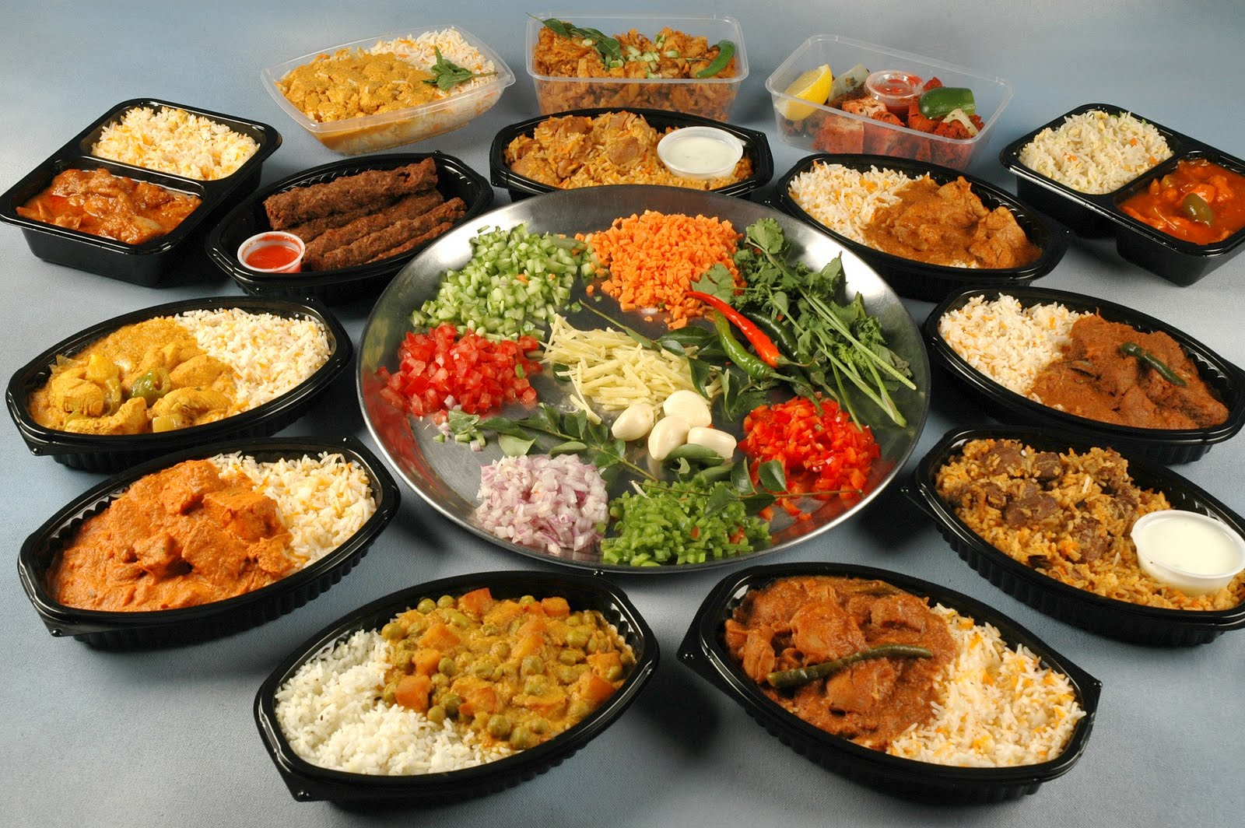
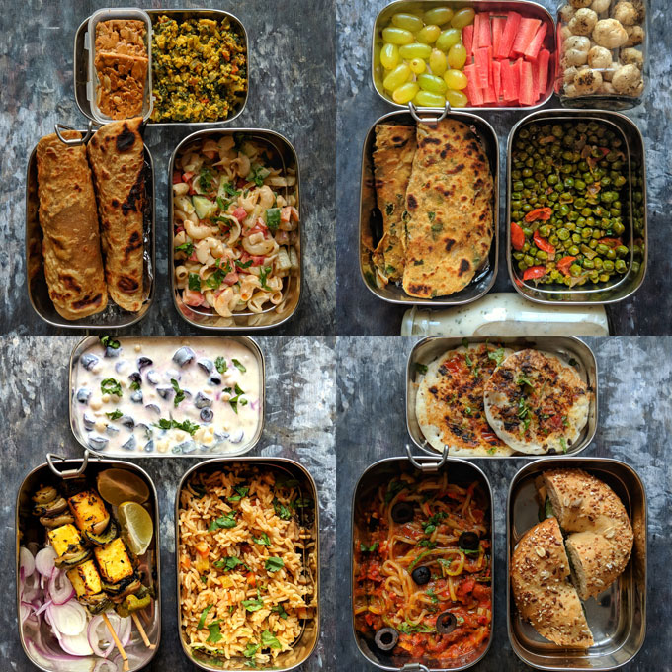
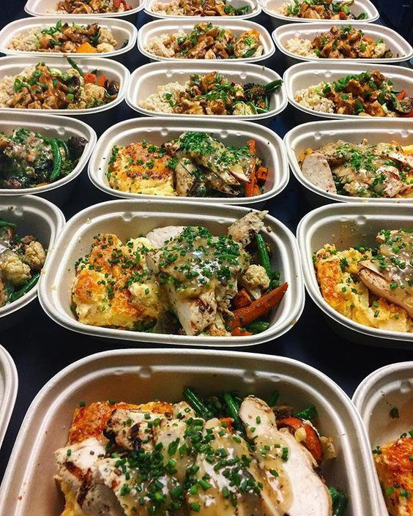
Implementing IOT & AI Based Food Quality Monitoring System
Supervised By:
Prof. Asanga Rathnaweera
E/17/285
Rathnayaka R.M.A.K.

Slide 2
Content
Introduction
Aims & Objectives
Methodology
Expected Outcomes
Project planning Timeline
Conclusion
References

Slide 3
1.Introduction
Implementing an IoT and AI-based food quality monitoring system involves combining the capabilities of IoT devices, sensors, and AI algorithms to collect, analyze, and manage data related to food quality
The system will use sensors to collect data related to food quality parameters such as smell, temperature, humidity, and pH level, and will analyze the data using AI algorithms to identify potential issues before they become serious.

Slide 4
What are the real world application of this project
Domestic uses
Canteen
Food making shops
Hotel industry

Slide 5
Why we need to monitor Quality of food
Food quality and safety are critical concerns for consumers, producers, and regulatory bodies. However, traditional methods of monitoring food quality are often slow, manual, and prone to errors.
This can lead to issues such as spoilage, contamination, and foodborne illness, which can have serious health and financial implications.

Slide 6
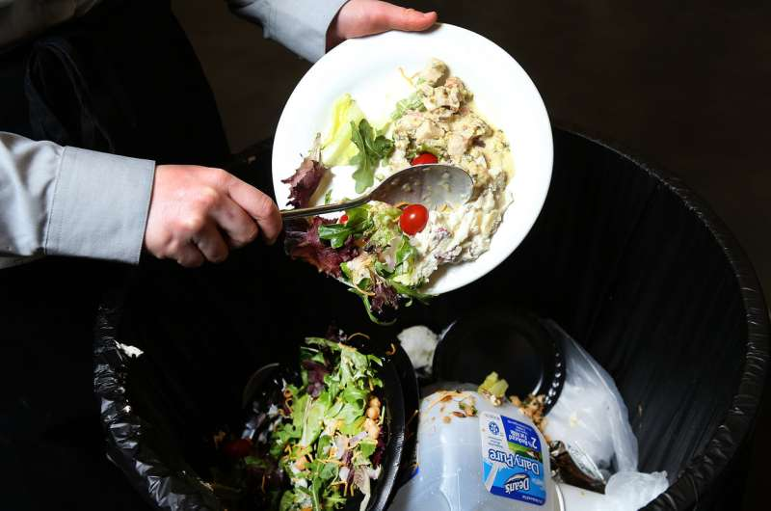

Why we need to monitor Quality of food
To reduce health issues
To prevent food wastage

Slide 7
2.Aims & Objectives
Aims:
The main aim of this project is to develop an IoT and AI-based food quality monitoring system that can monitor the quality parameters of food products in real-time and alert relevant personnel when there are any issues or potential risks.
The system should provide a reliable and efficient way to ensure that food products meet quality standards and are safe for consumption.

Slide 8
Project Objectives:
To develop an IoT-based system for real-time monitoring of food quality parameters such as smell, temperature, humidity, and pH level.
To implement AI algorithms for analysis of the collected data to identify potential issues and trends.
To provide an alert system to notify relevant personnel when food quality parameters go outside of acceptable ranges.
To provide data visualization tools for easy analysis of the collected data.

Slide 9
3.Methodology
Define the food quality parameters
Choose the appropriate sensors
Designing and build the sensor
Testing the sensor for selected food under different conditions and take the dataset
Using above dataset train the model to find the quality of any other food.
Implement AI algorithms for data analysis.
Optimizing the sensor performance
Develop an alert system for notification of relevant personnel.
Use data visualization tools for easy analysis of the collected data.

Slide 10
Choose the appropriate sensors
Define the food quality parameters
Aroma/smell(gas concentration)
Color
Air quality
Humidity
pH value
Temperature
Pressure

Slide 11
Choose the appropriate sensors
Main sensors that are used in this project
Gas sensors
A gas sensor, such as a carbon dioxide or oxygen sensor, is used to measure the concentration of gases in the environment surrounding the food. The concentration of gases can affect the microbial growth and quality of the food.
MQ-2: The MQ-2 sensor is a general-purpose gas sensor that can detect gases such as smoke, propane, and methane. It is relatively low-cost and has a high sensitivity to these gases.
MQ-5: The MQ-5 sensor is a gas sensor that can detect gases such as natural gas, liquefied petroleum gas (LPG), and carbon monoxide (CO). It has a high sensitivity and can detect gases at low concentrations.
MQ-7: The MQ-7 sensor is a gas sensor that can detect carbon monoxide (CO) gas. It is sensitive and can detect CO at low concentrations.

Slide 12
Air Quality
MQ-135: The MQ-135 sensor is a gas sensor that can detect gases such as ammonia, nitrogen oxides, benzene, and smoke. It has a high sensitivity to these gases and can detect them at low concentrations.
Color sensors
A color sensor can be used to measure the color of the food, which is an important quality factor for many food products, such as meat, fruits, and vegetables.
TCS3200
Camera Module – OV7670

Slide 13
Temperature and Humidity
Temperature is an important parameter in determining food quality, as it affects the rate of microbial growth, enzymatic activity, and chemical reactions.
A humidity sensor, such as a capacitive or resistive sensor, is used to measure the relative humidity of the environment surrounding the food. Humidity affects the water activity of the food, which can impact its microbial stability, texture, and shelf life.
DHT11
pH value
A pH sensor is used to measure the acidity or alkalinity of the food. pH is an important factor in determining the safety and quality of many foods, such as dairy products, meats, and fruits.
Liquid PH Value Detection Detect Sensor Module

Slide 14
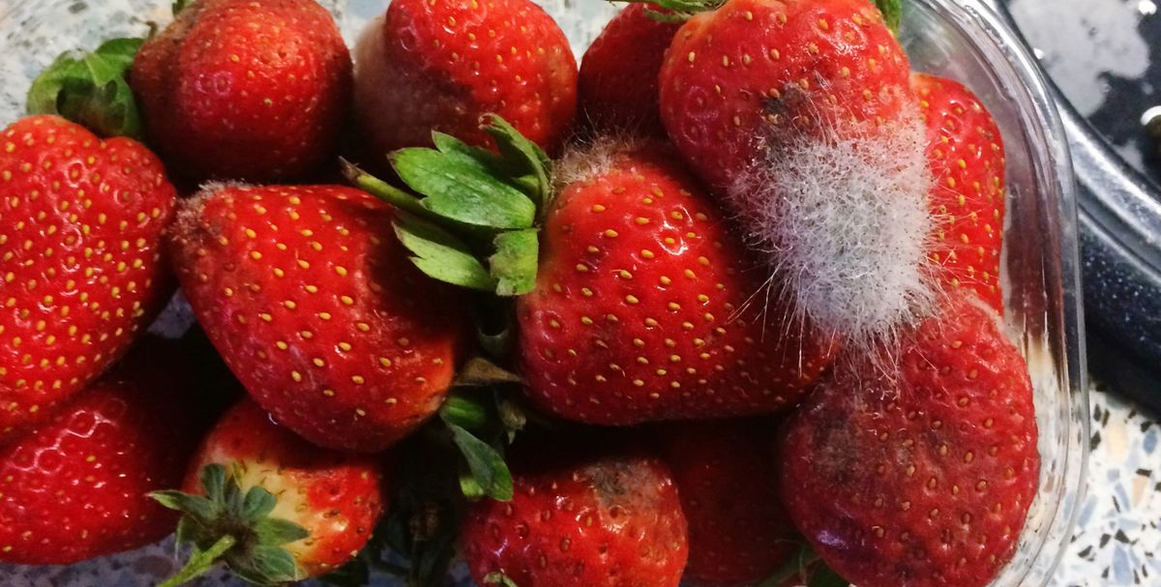

Food Quality Assessment through Gas Analysis: A Glimpse into Gaseous Signatures of Freshness
1. Fruits:
- Ethylene: A natural plant hormone responsible for fruit ripening. Fruits like bananas, apples, and tomatoes release ethylene as they ripen.
2. Dairy Products:
- Ammonia: Can indicate spoilage in dairy products like milk and cheese.

Slide 15
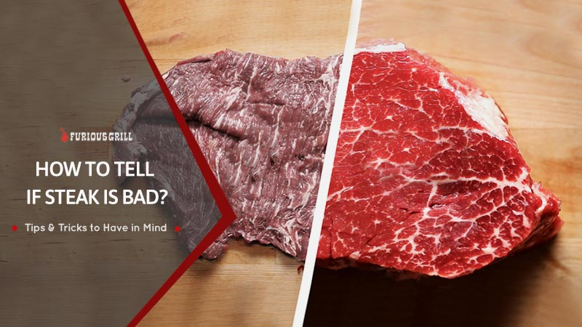
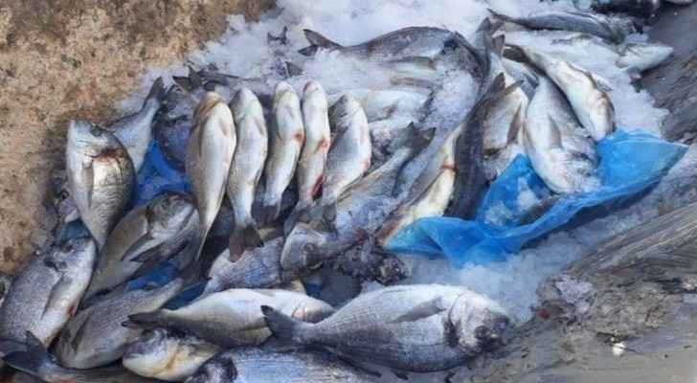
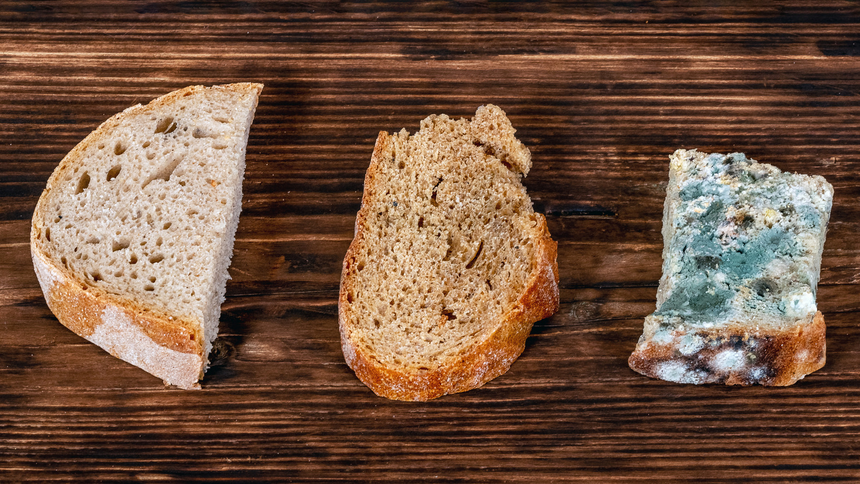
3. Meat:
- Sulfur Compounds: Spoilage of meat products can result in the release of sulfur compounds, leading to a foul smell.
4. Fish:
- Trimethylamine (TMA): The "fishy" smell associated with fish spoilage is often due to the release of TMA.
5. Bread and Bakery Items:
- Acetic Acid: Can be produced by spoilage microorganisms in baked goods.

Slide 16
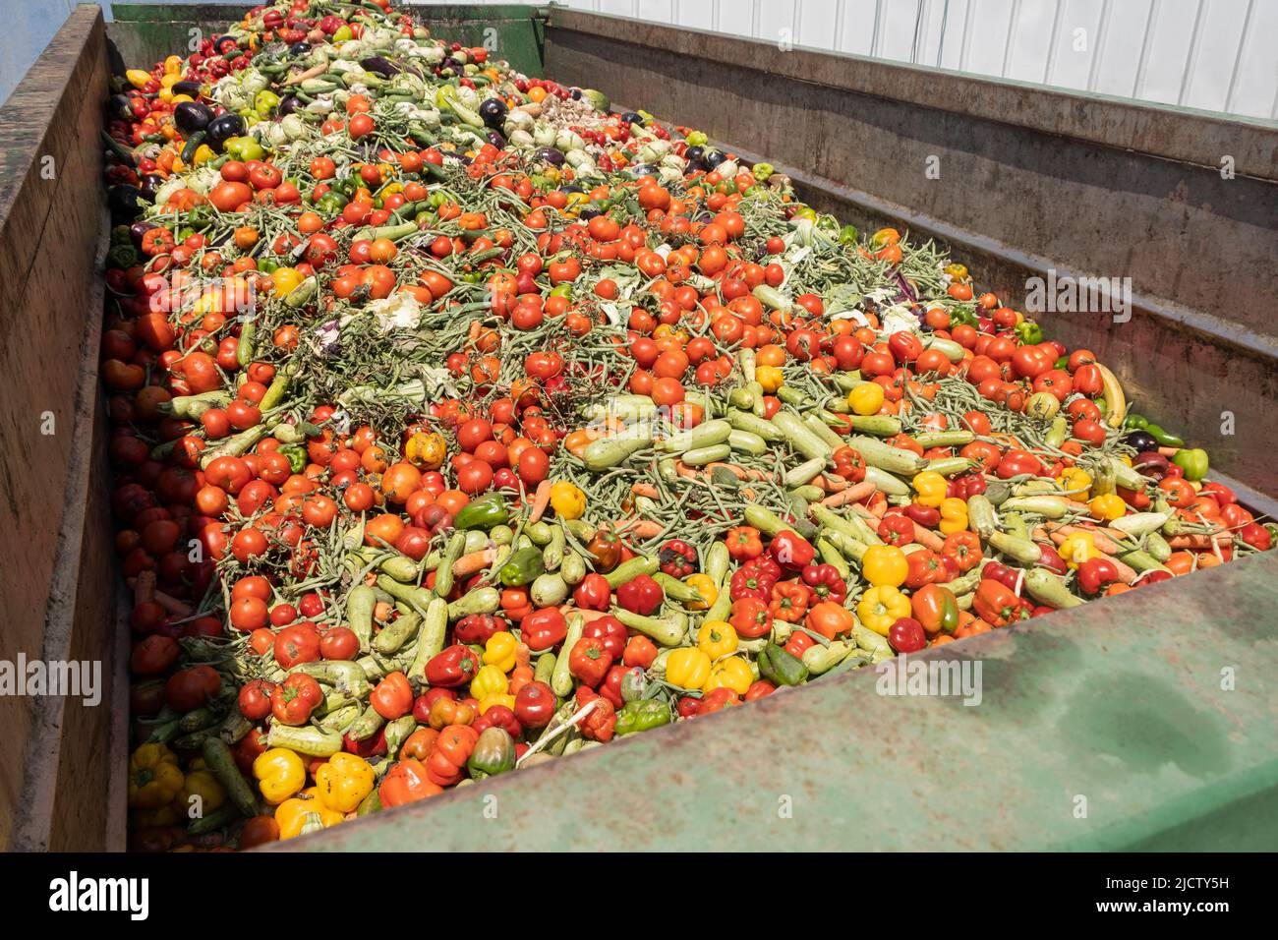
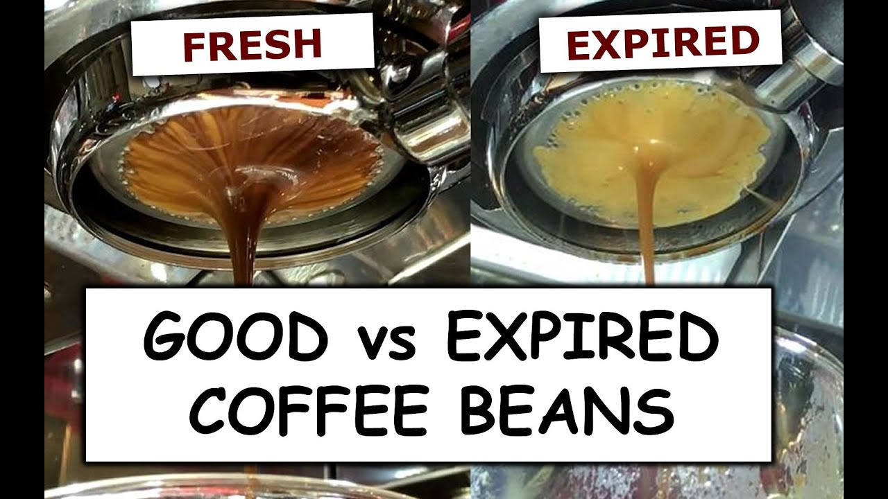
6. Vegetables:
- Methane and Ethylene: Vegetables such as broccoli and cabbage can release gases like methane and ethylene during degradation.
7. Coffee:
- Carbon Dioxide (CO2): Freshly roasted coffee beans release CO2 as they degas after the roasting process.

Slide 17
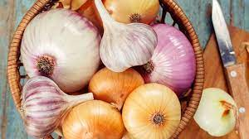
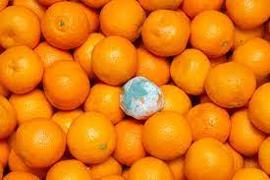
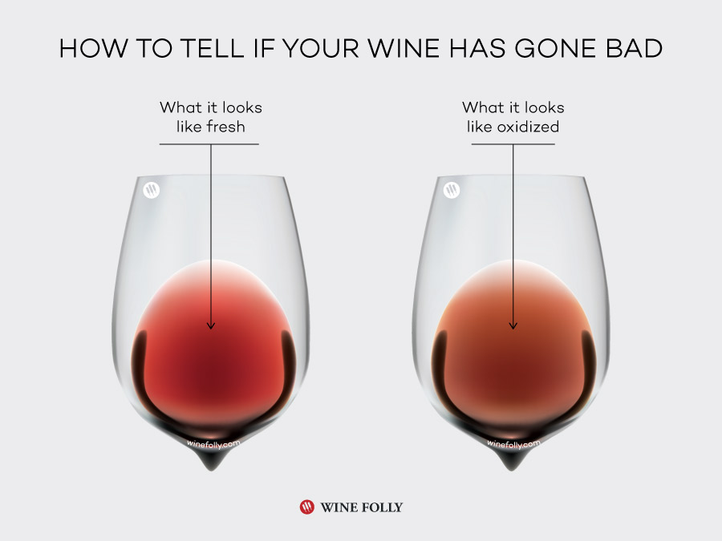
8.Onions and Garlic:
- Sulfur Compounds: These vegetables release sulfur compounds when they are cut or damaged.
9. Citrus Fruits:
- Limonene: Citrus fruits release limonene, which contributes to their characteristic aroma.
10. Wine:
- Carbon Dioxide (CO2) and Ethanol: During fermentation, yeast produces CO2 and ethanol in wine.

Slide 18
4.Expected Outcomes:
Real-time monitoring of food quality parameters such as temperature, humidity, and pH level.
Early identification of potential issues and trends using AI algorithms.
Notification of relevant personnel when food quality parameters go outside of acceptable ranges.
Easy analysis of the collected data using data visualization tools.
Improved food quality and safety.
Reduce food wastage

Slide 19
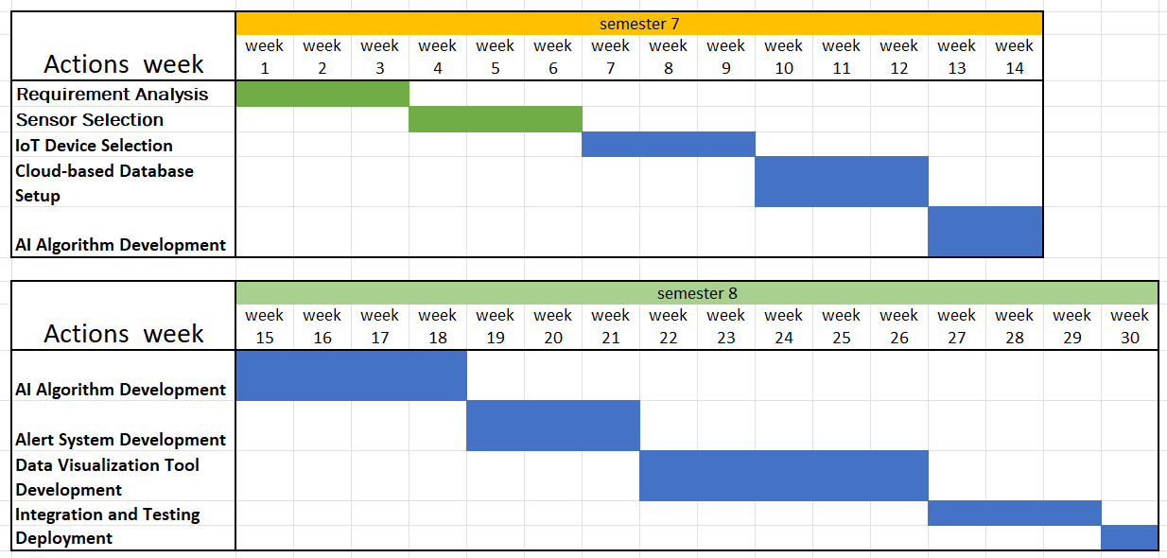
5.Project planning

Slide 20
Conclusion
The proposed IoT and AI-based food quality monitoring system will help improve food quality and safety by providing real-time monitoring of food quality parameters, early identification of potential issues, and easy analysis of the collected data.

Slide 21
References
Symmetry | Free Full-Text | An Intelligent IoT-Based Food Quality Monitoring Approach Using Low-Cost Sensors (mdpi.com)
Application of Artificial Intelligence in Food Industry—a Guideline | SpringerLink
ICT applications for the food industry – ScienceDirect
An IoT and Machine Learning-Based Model to Monitor Perishable Food towards Improving Food Safety and Quality (hindawi.com)
IoT Based Food Monitoring System (iotdesignpro.com)
(PDF) Smart Food Monitoring System (researchgate.net)

Slide 22

Thank You
Any
Questions?

